Slide 1
Power Consumption Forecasting
Eva Burns
05/25/2023

Slide 2
Agenda
01
Problem statement
04
Data Processing & Transformations
07
Results & Learnings
Assumptions & Hypotheses
02
05
Feature Engineering
08
Future work
Data properties & EDA
03
06
Proposed Approaches

Slide 3

Problem Statement
A power consumption study in 2017 was done at Tétouan, Morocco by the Supervisory Control and Data Acquisition System (SCADA) of Amendis
The energy distribution network of Tétouan is powered by 3 Zone stations: Quads, Smir and Boussafou
The purpose of this project is to study and forecast power consumption in Tétouan
I will only focus on forecasting Zone 1’s (Quads) power consumption
I will be forecasting 12/11/2017 – 12/31/2017

Slide 4
Data Description
The data was found on Kaggle and was collected every ten minutes for
exactly one year (1/1/2017 0:00 - 12/30/2017 23:50) with nine columns:
Datetime: Time window of ten minutes
Temperature: Weather Temperature
Humidity: Weather Humidity
WindSpeed: Wind Speed
GeneralDiffuseFlows: “Diffuse flow” is a catchall term to describe low-temperature (< 0.2° to ~ 100°C) fluids that slowly discharge through sulfide mounds, fractured lava flows, and assemblages of bacterial mats and macrofauna
Diffuse Flows
PowerConsumption_Zone1: This is what will be forecasted
PowerConsumption_Zone2
PowerConsumption_Zone3

Slide 5
Assumptions & Hypotheses
Assumption: The data was actually collected every ten minutes. Also, that the sensors were calibrated correctly throughout the year.
Hypothesis: a model with a seasonal component will be most appropriate.
Possibly be two seasonalities: daily and yearly.
Throughout the day, power consumption changes. For example, when you are sleeping, power consumption is lower because you are not using appliances or lights around your house.
I also think power consumption changes yearly as weather changes during the seasons, affecting AC/heating consumption. However, since this data only covers 2017, yearly seasonality will not be able to be used effectively

Slide 6
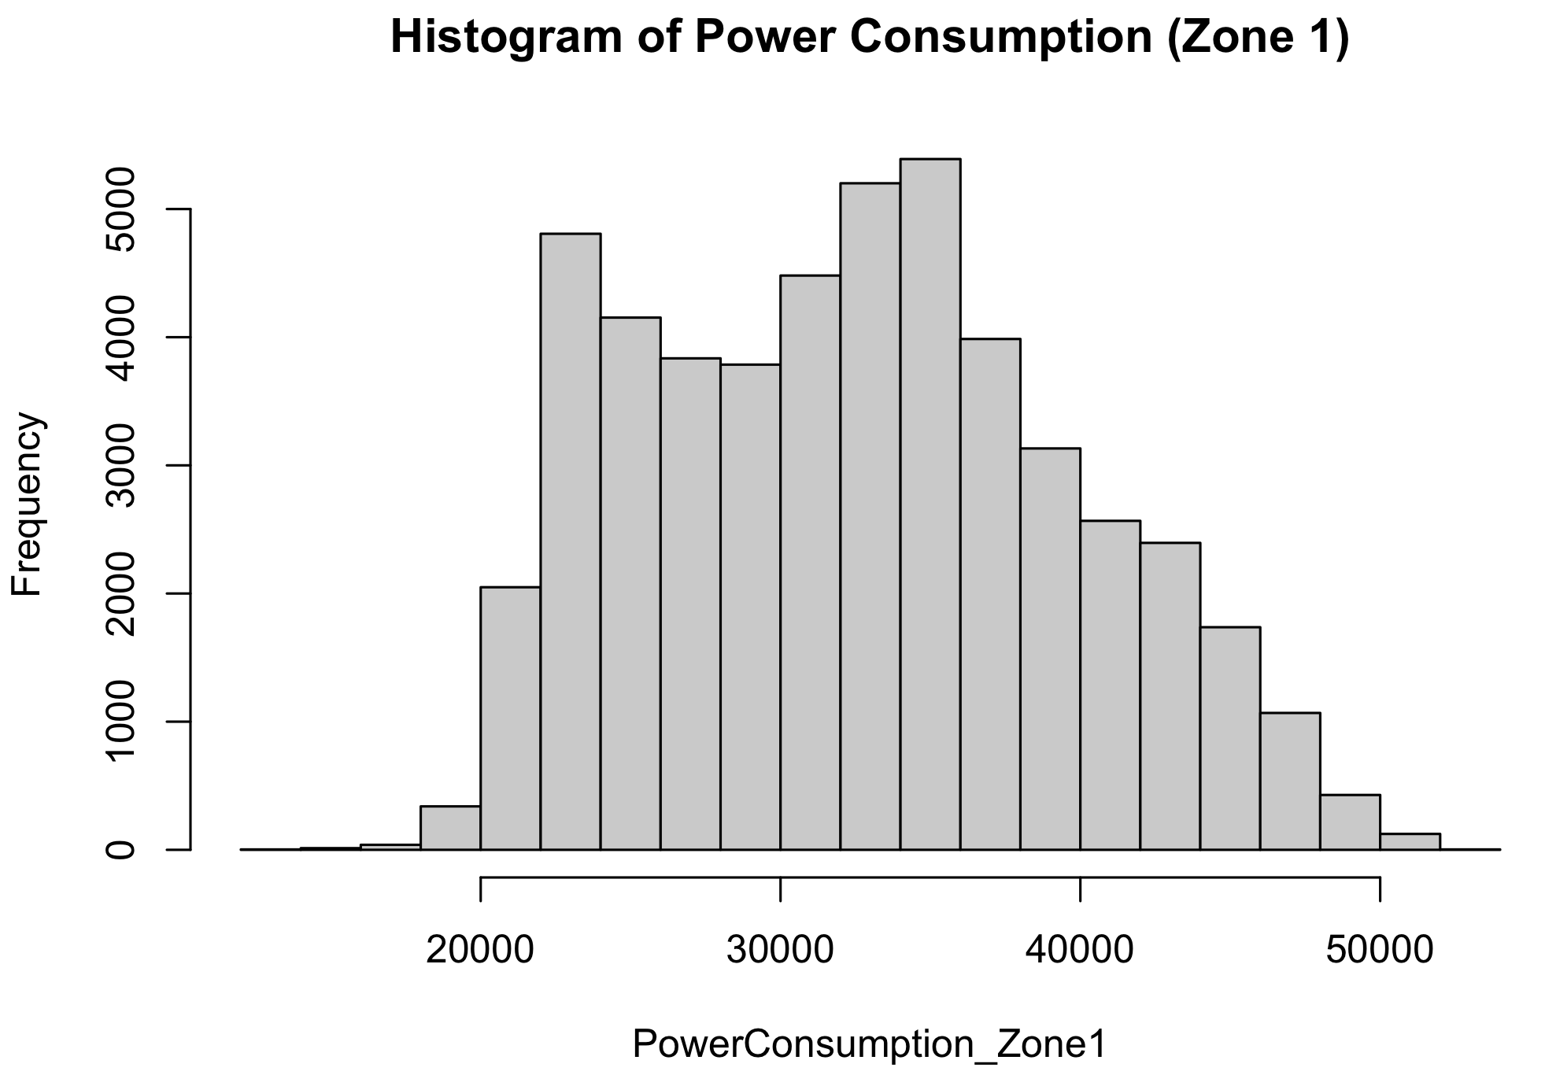
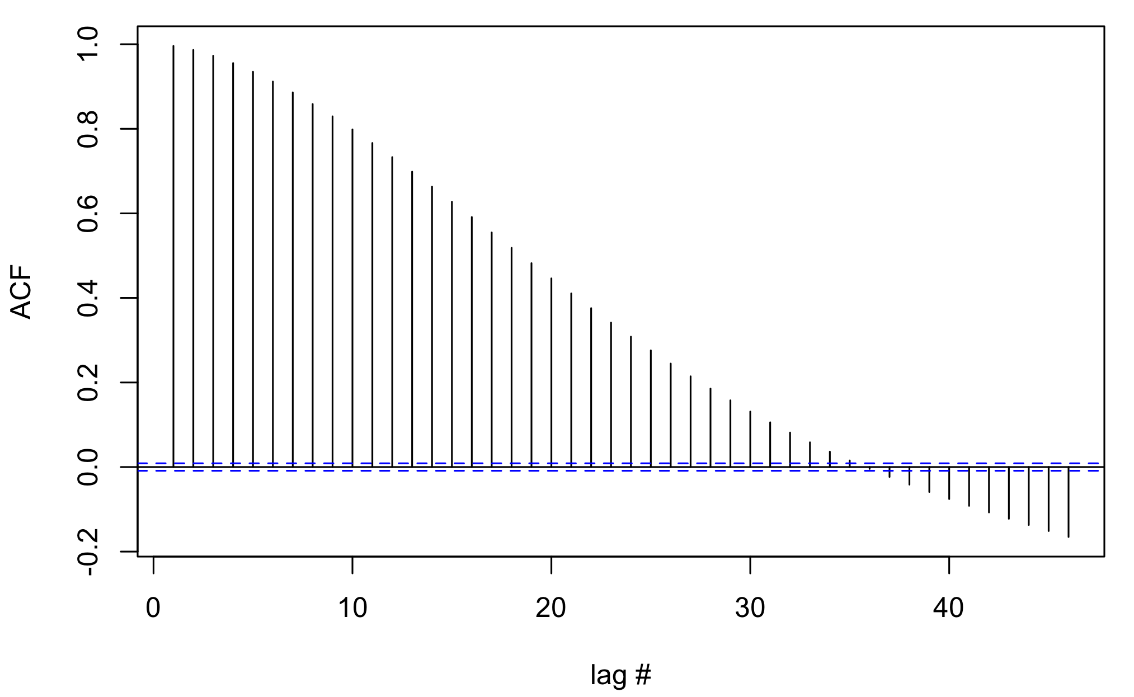
Data Properties
ADF test p-value: 0.01
KPSS test p-value: 0.01
While the ADF test gives a low p-value concluding that the data is stationary, the ACF plot and KPSS indicate the data is non-stationary since the KPSS p-value is low and the ACF plot does not die down quickly

Slide 7
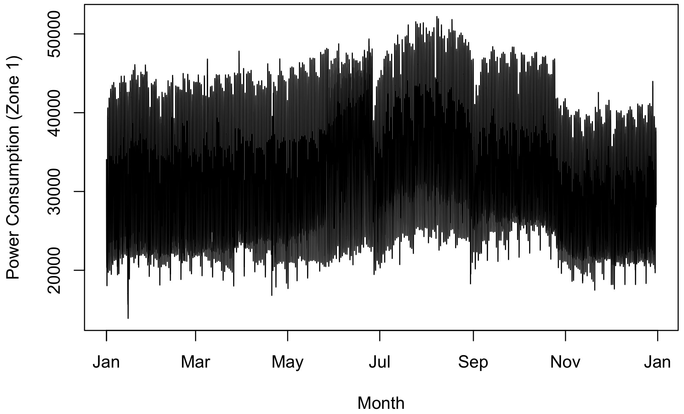
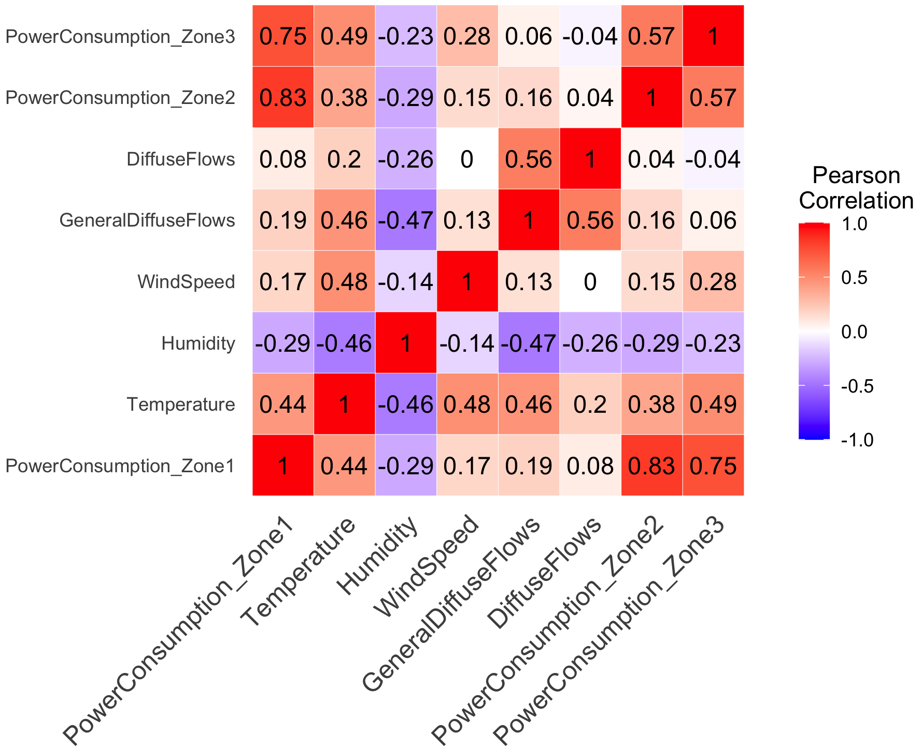
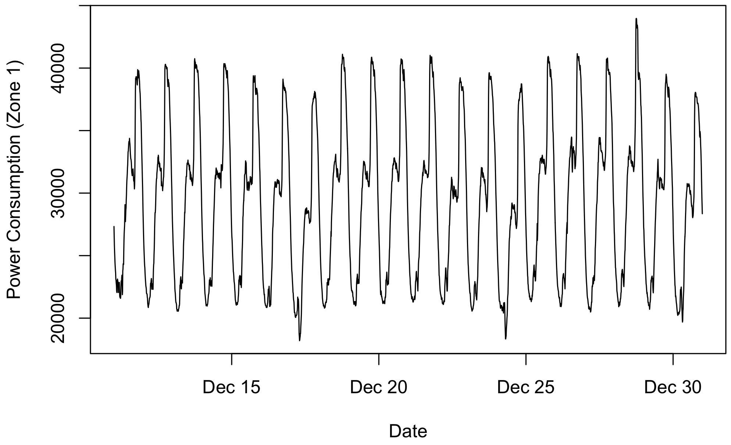
Exploratory Data Analysis
The power consumption in Zones 2 and 3 are the most correlated with power consumption in Zones 1

Slide 8
Data Processing
Outliers/Anomalies
Checked using tsoutliers
No outliers found, so no data needs to be replaced
Missing Values
The data is full and collected at regular intervals with no null values
No cleaning is required

Slide 9
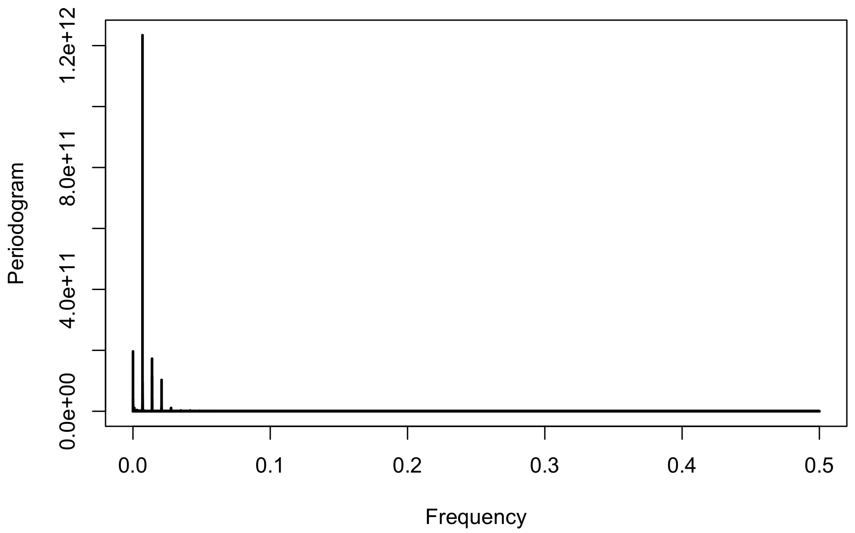
Feature Engineering
A frequency periodogram was applied to the power consumption (Zone 1) to determine if/what the seasonal period is
Seasonality with the highest frequency is 144.092
Indicates there is daily seasonality since the data is collected in 10-minute increments
1440 minutes in a day, which divided by 10 minutes is 144

Slide 10
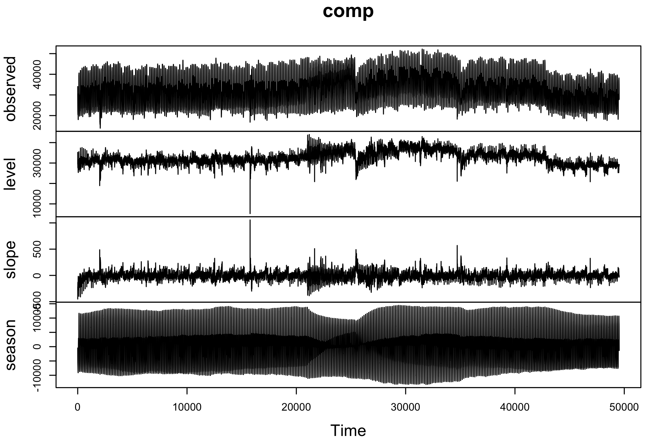
Proposed Approach - TBATS
Trigonometric regressors to model multiple-seasonalities
Box-Cox transformations
ARMA errors
Trend
Seasonality
However, it is a complex model, so there is risk of overfitting the train data, as well as the model being computationally expensive
I built the TBATS model using the train data (1/1/2017 00:00 - 12/10/2017 23:50) with a seasonal period of 144.

Slide 11
Proposed Approach - SARIMA
SARIMA also handles seasonality but is a simpler model. This will make the time to create the model faster, and may help with overfitting
I built the SARIMA model using the train data (1/1/2017 00:00 - 12/10/2017 23:50) using auto.arima with a seasonal frequency of 144.
Model: ARIMA(3,0,0)(0,1,0)[144]

Slide 12
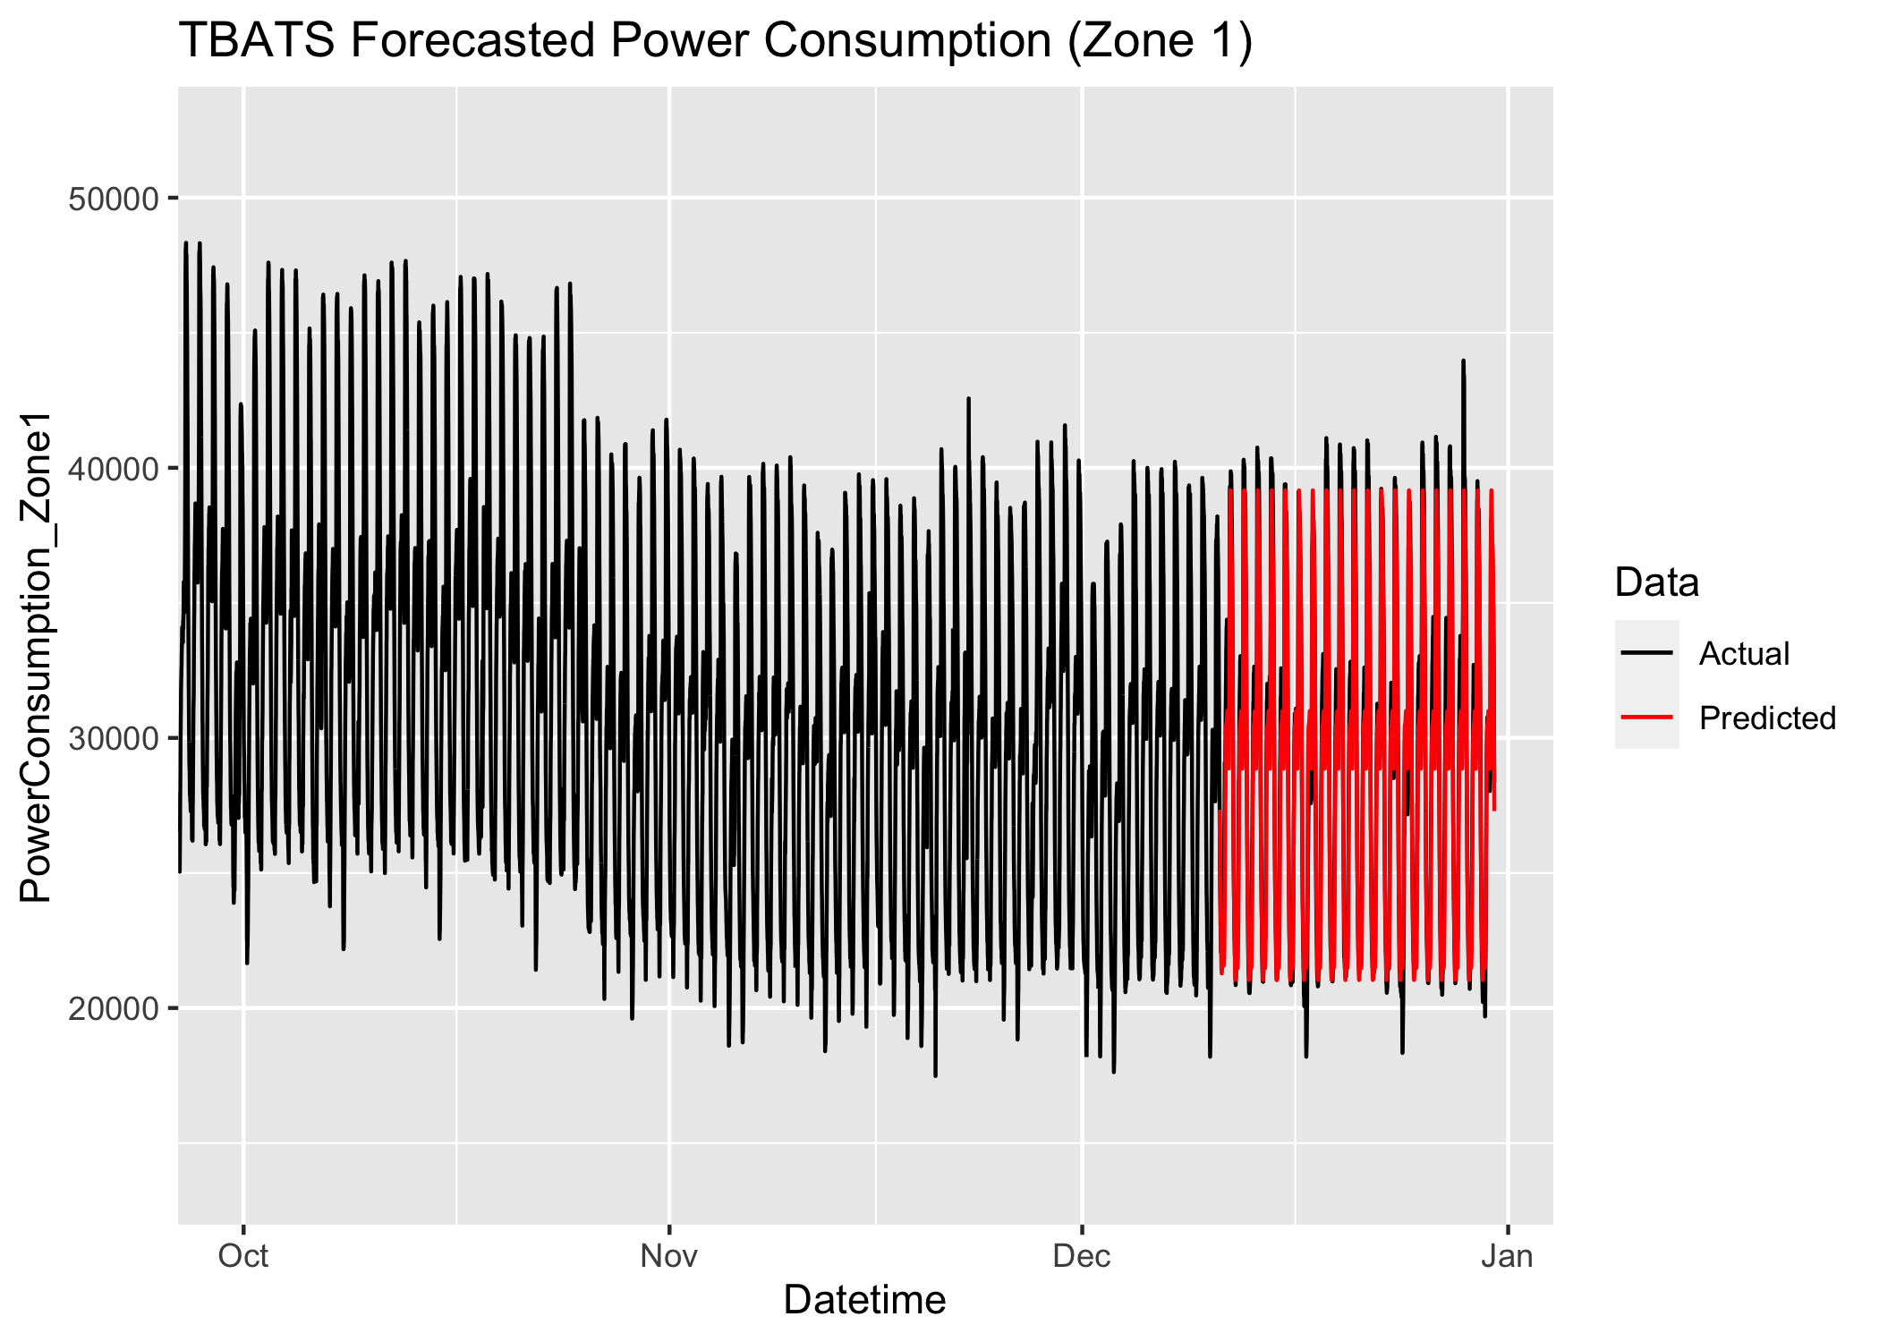
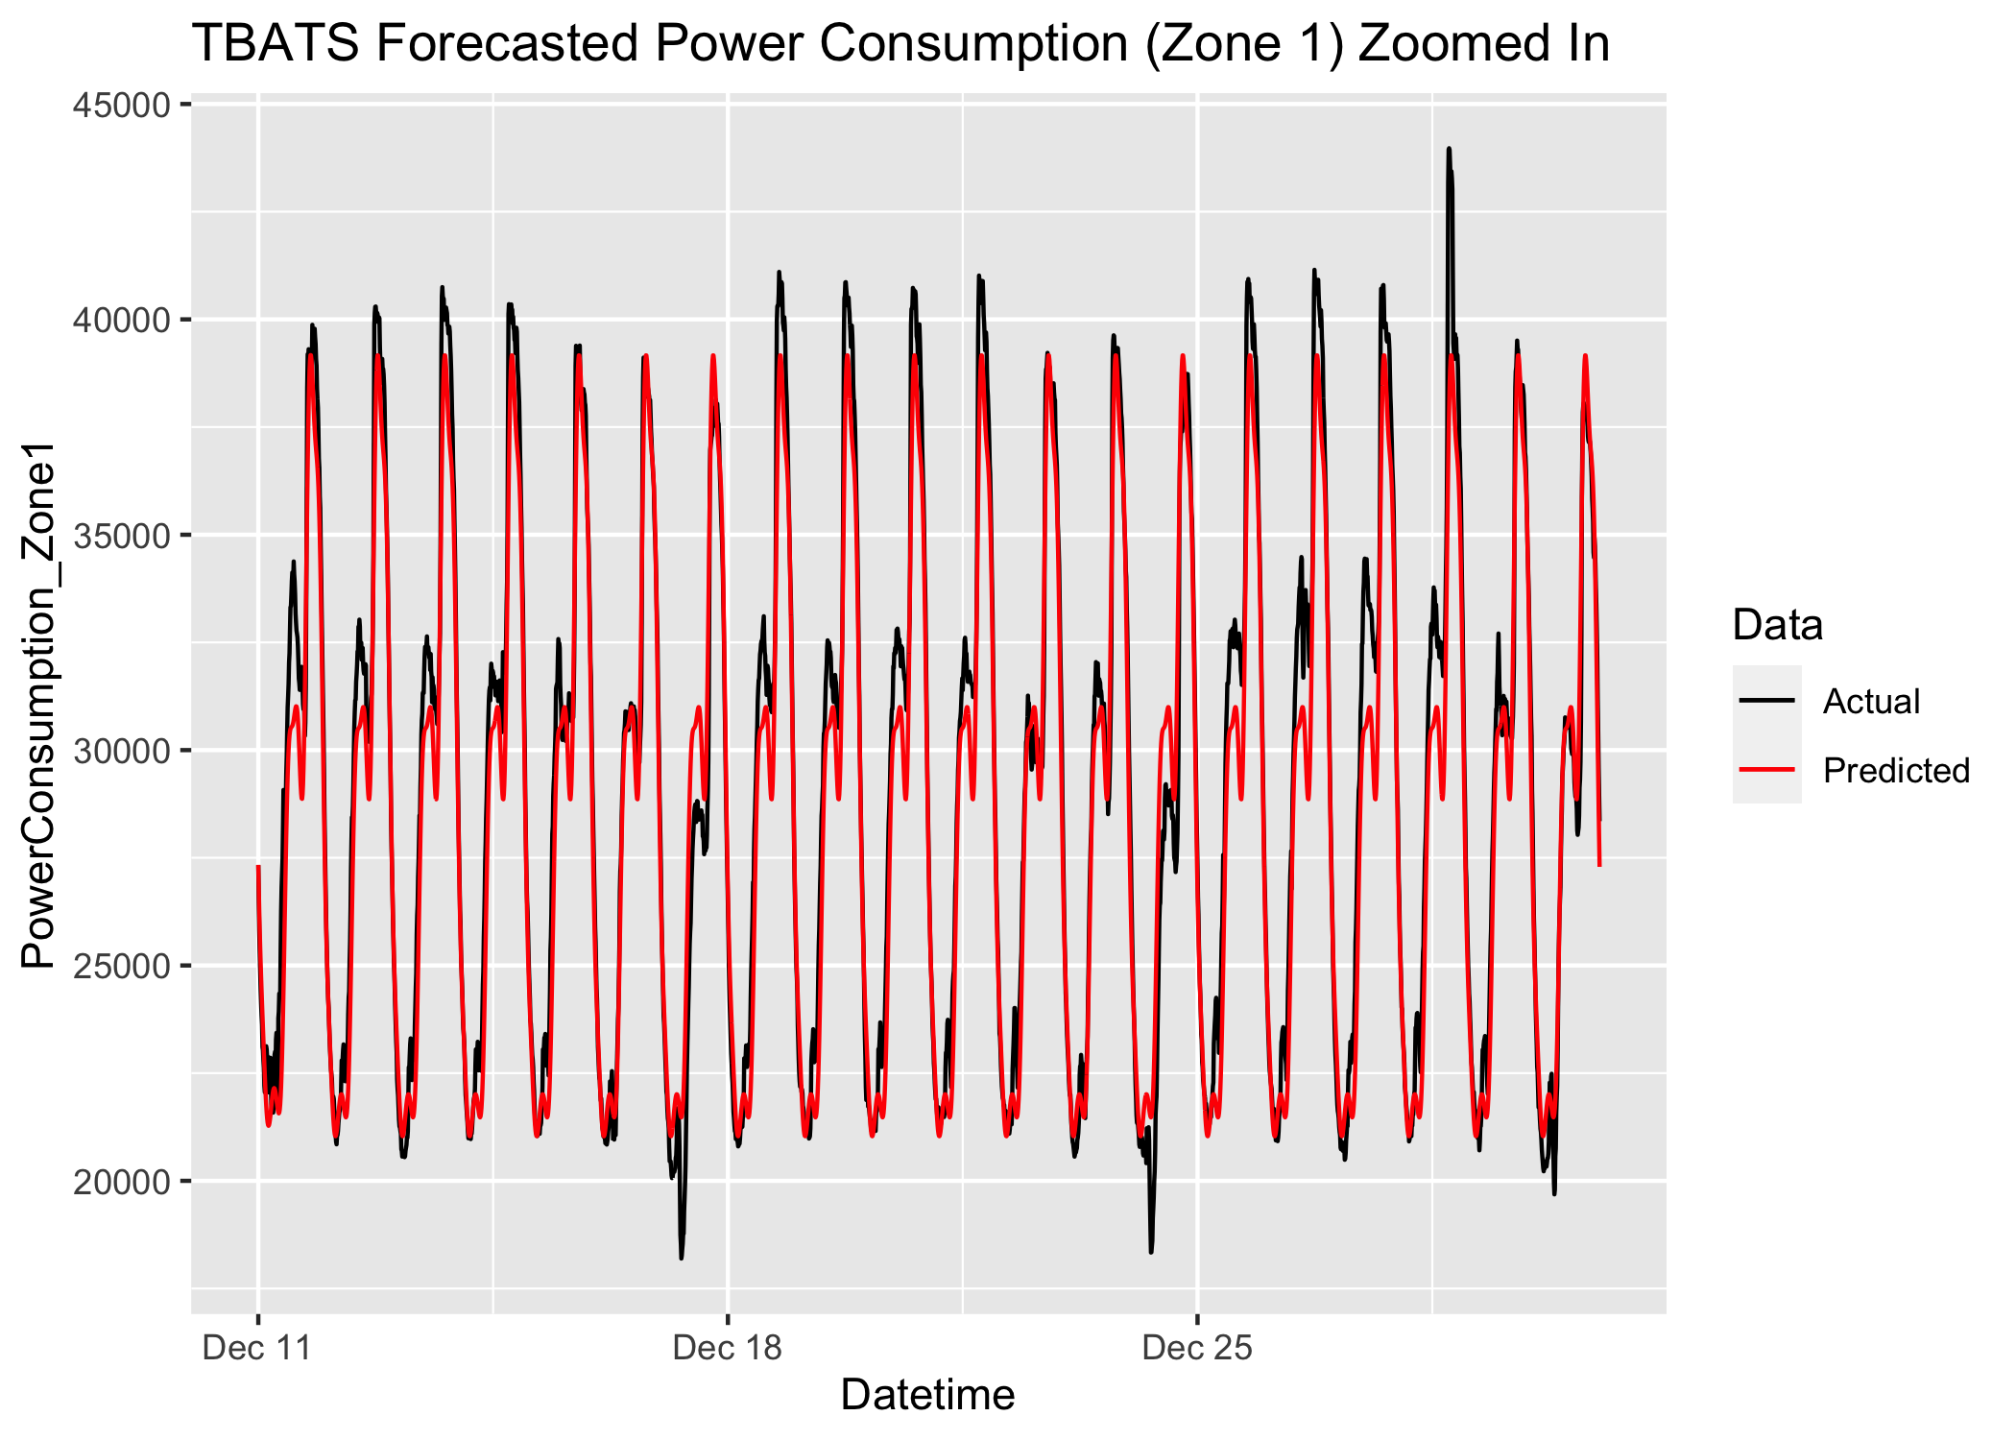
Results - TBATS
 | ME | RMSE | MAE | MPE | MAPE | MASE
Train | 0.474 | 410.923 | 260.04 | -0.010 | 0.820 | 0.600
Test | 674.98 | 1491.04 | 1156.175 | 1.957 | 3.909 | 2.666

Slide 13
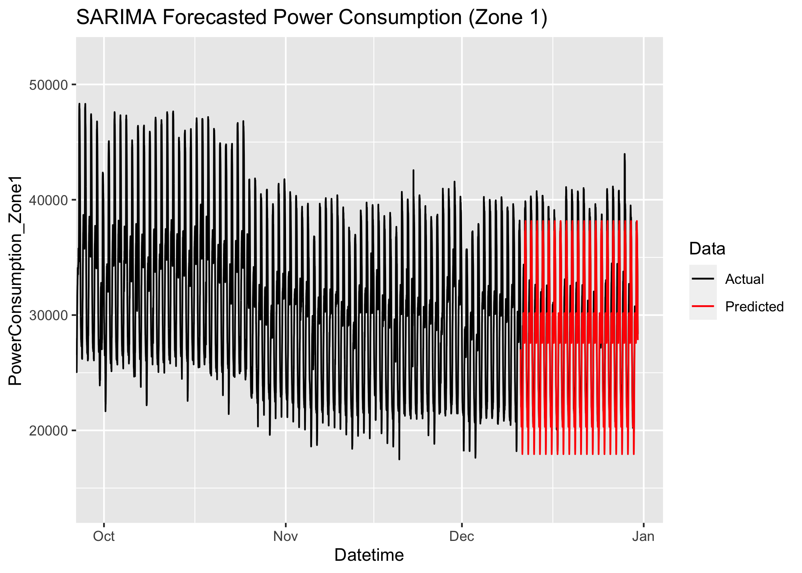
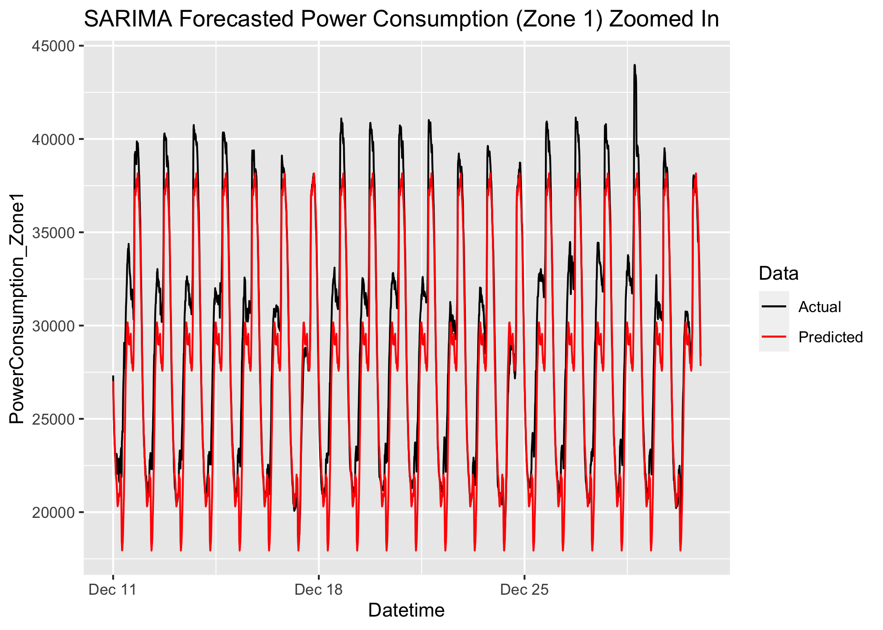
Results - SARIMA
 | ME | RMSE | MAE | MPE | MAPE | MASE
Train | 0.142 | 438.935 | 266.596 | -0.011 | 0.852 | 0.615
Test | 1638.84 | 2377.233 | 1802.43 | 5.495 | 6.144 | 4.156

Slide 14
Comparison of Models
TBATS performed better that SARIMA on all accuracy metrics for the test data
It should be noted that the accuracy of the training data on both models were about equal. This tells us that the SARIMA model overfit the training data.

Slide 15
Future Work
The current dataset ignores one of the main capabilities of the TBATS model: multiple seasonality. I believe there is yearly seasonality to this data because of how weather changes throughout the year
However, this data is only for 2017, so yearly seasonality cannot be used on this project. If more data from multiple years were used, the TBATS model could be even more accurate because it can handle both daily and yearly seasonality
In other words, in the future I believe that collecting more data for multiple years will yield an even more accurate TBATS model because it can be built on multiple seasonalities: daily and yearly.

Slide 16
Thank you!

